Slide 1
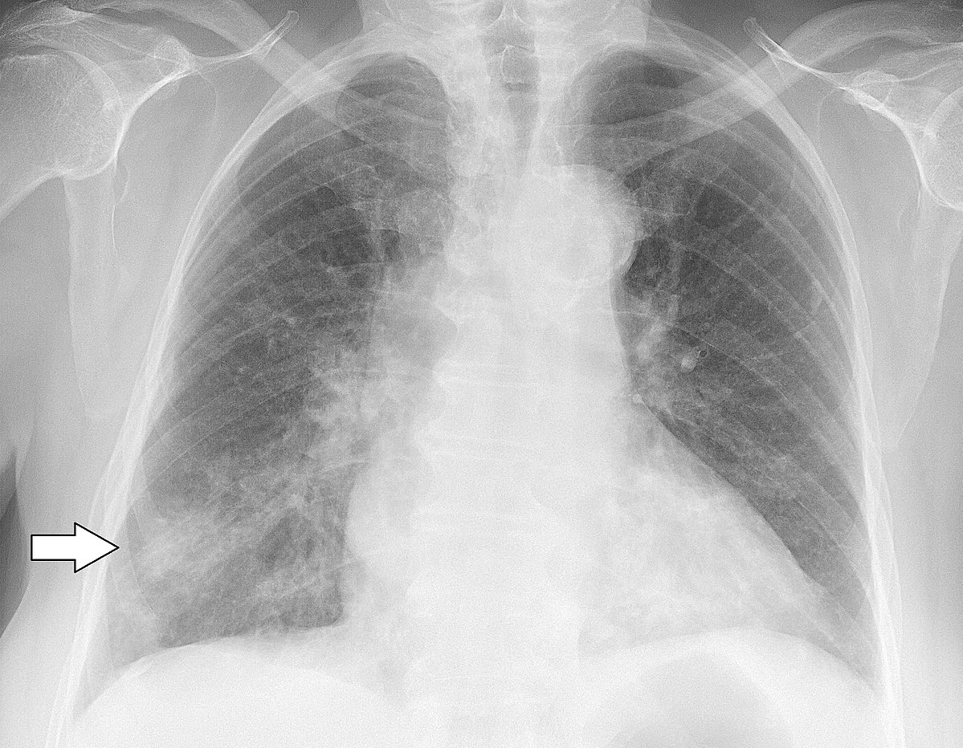
Pneumonia Detection using Deep Learning
Md Asaduzzaman Jabin
Graduate Student
School of Electrical and Computer Engineering
University of Georgia, GA-30602
Email: mj71006@uga.edu

Slide 2
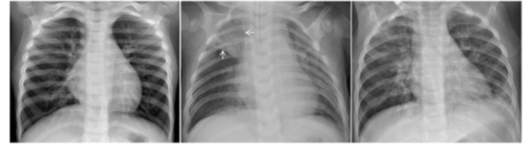
Introduction
Research Question
Detect Pneumonia from X-ray image using Deep Learning
Pneumonia :
an infection that inflames the air sacs- fluid, purulent material in one or both lungs. Organisms including bacteria, viruses and fungi, can cause pneumonia.
11% mortality rate/ month for infants and young children, people older than age 65
Normal
Bacterial Pneumonia
Viral Pneumonia

Slide 3
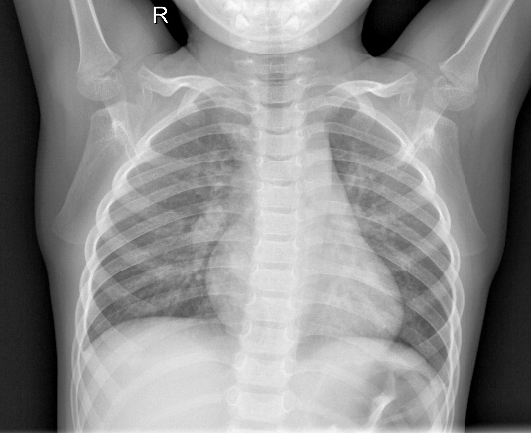
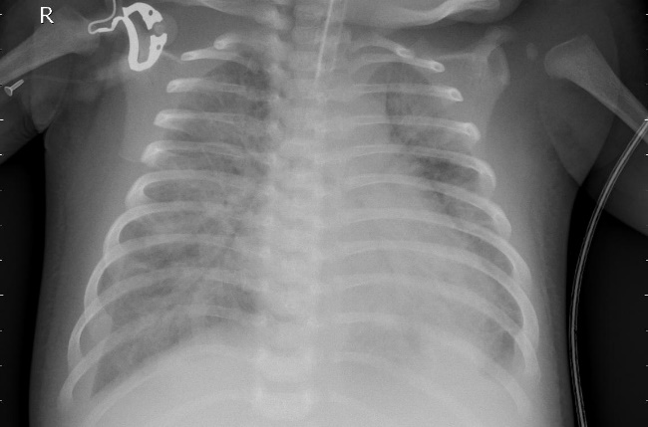
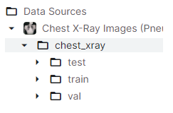
Data Set
Kaggle: https://www.kaggle.com/code/kashyapgohil/pneumonia-detection-using-cnn/data
Normal
Pneumonia
5,863 images, 2 Class (Normal/ Pneumonia) → 1.24 GB
Base: Training set : Validation Set : Testing Set = 5216: 16: 624 (each class)
Cleaned data → done by clinician

Slide 4
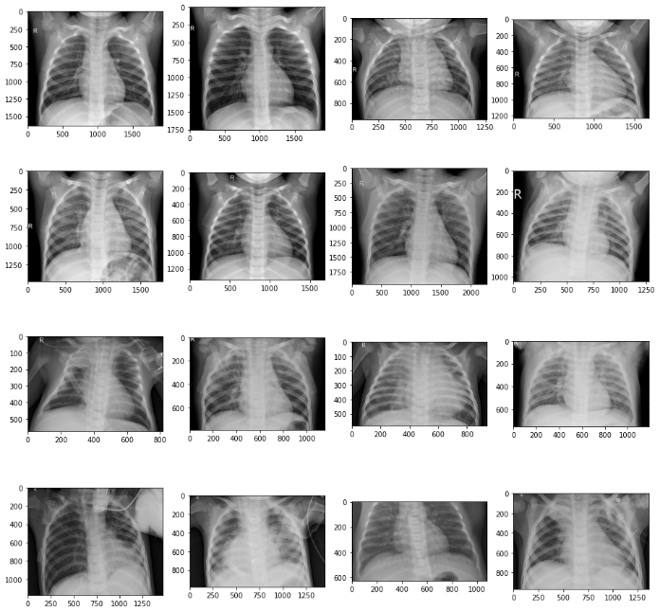
Initial Plan
1. Access and Load data
2. Preprocess
3. Define Model
4. Model Training
Merge Base train + validation = 80:20 = 4185: 1047
Total data distribution: 70: 20:10 (Train: Validation: Test)
Trained three different models: (Base Accuracy)
Simple CNN model → 91%
VGG-16 model → 51%
ResNet50 model → 74%
Inception model → 89%
Saved the model which gave best accuracy.
Loss: Binary_crossentropy, Relu/sigmoid/ softmax,
Adam/ RMSProp/SDG, Lr = .003/0.00003,
Created a django app for making the classification.
Code:
https://www.kaggle.com/code/kashyapgohil/pneumonia-detection-using-cnn/notebook
https://www.kaggle.com/code/abhishekdhule/pneumonia-detection-resnet-inception-tensorflow/notebook?scriptVersionId=40311825
5. Model Tuning
6. Result
Workflow

Slide 5
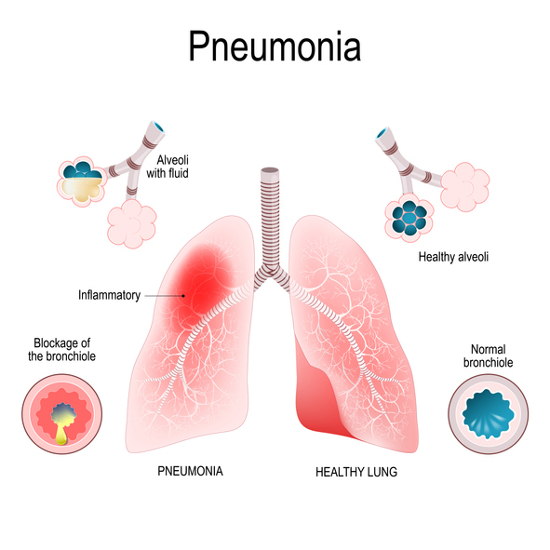
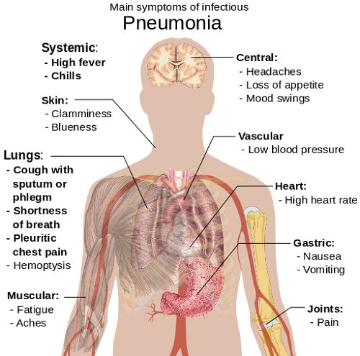

Slide 6
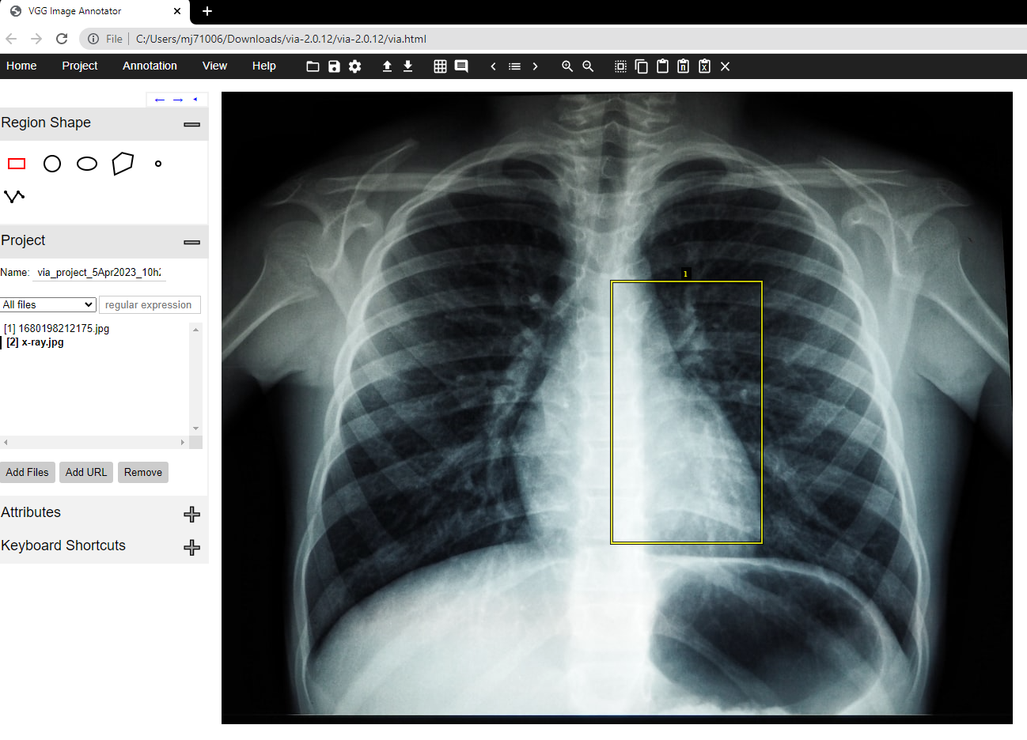
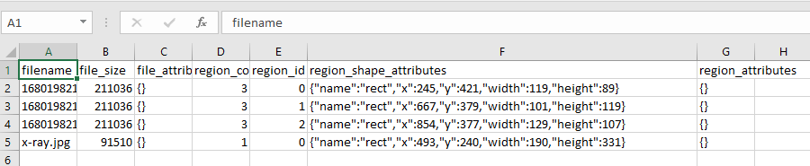
Image Annotation

